Slide 1
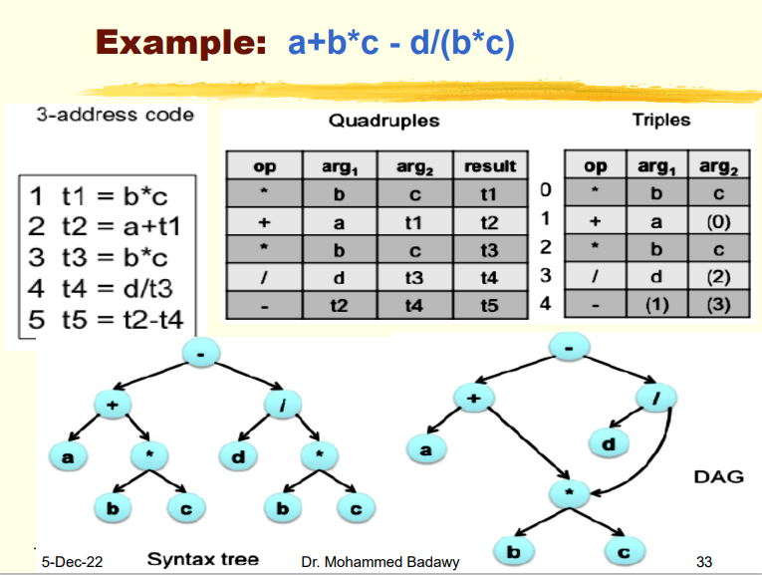
Compiler
3 address code

Slide 2
Compiler
3 address code

Slide 3
Compiler
3 address code

